Slide 1
Blue Hill Country Club
Data Warehouse Design

Slide 2
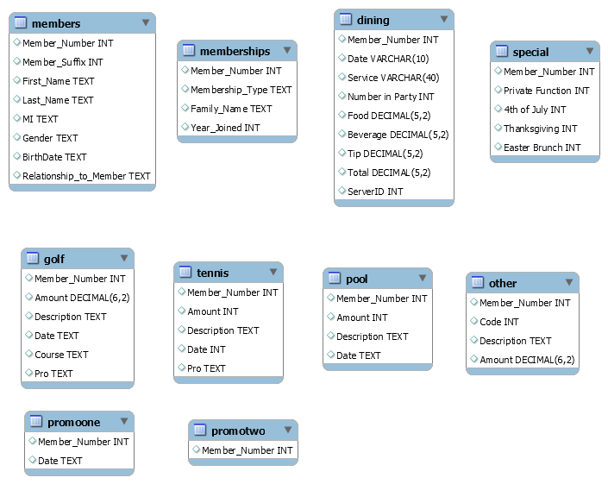
Data Introduction
Raw Database - contains the 10 tables, with transactional data（50,000+） related to one year of operations of Blue Hill Country Club.

Slide 3
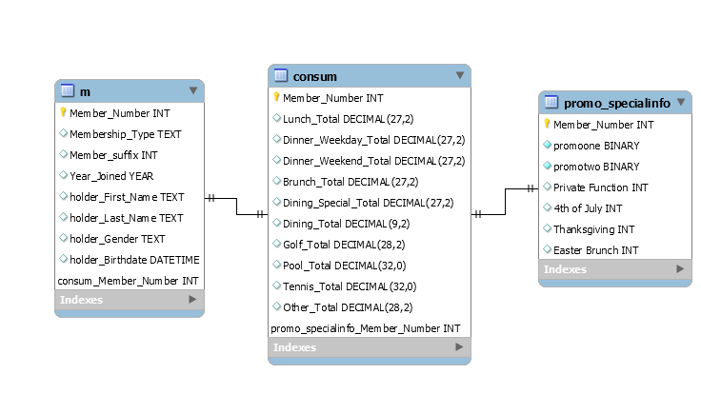
Data Warehouse Design（through ETL process）
Table m contains demographic information of members
Table consum contains consumption data of each membership account
Table promo_specialinfo contains data of whether signed up for promotion and whether attended special functions in each membership account

Slide 4
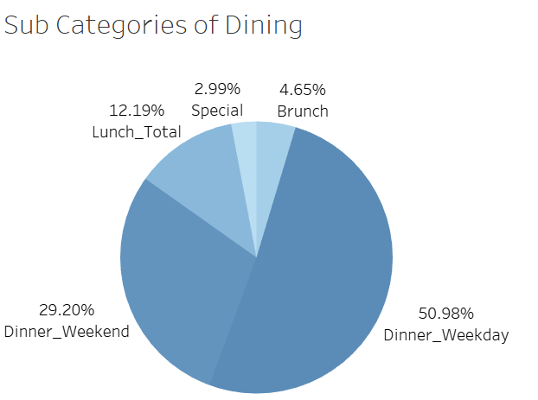
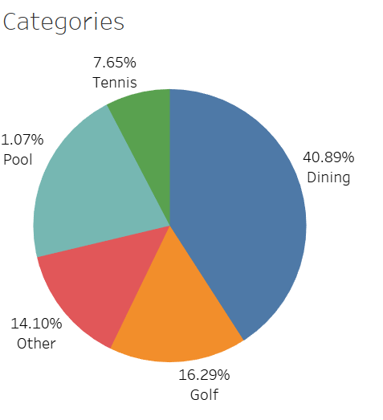
Revenue Generated by Each Category
Dining contributes the most to the club.
Within dining, dinner on weekday is the most contributing one.

Slide 5
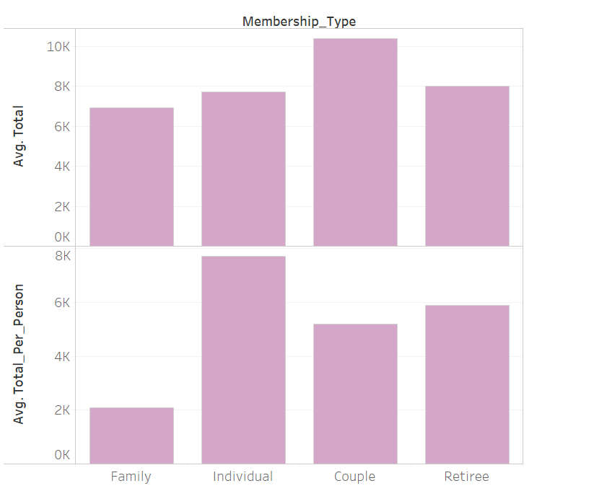
Consumption Amount of Different Types of Members
On average:
For each membership account, couple spend most. While for each person, individuals spend most.
Both from total generated value and value per person

Slide 6
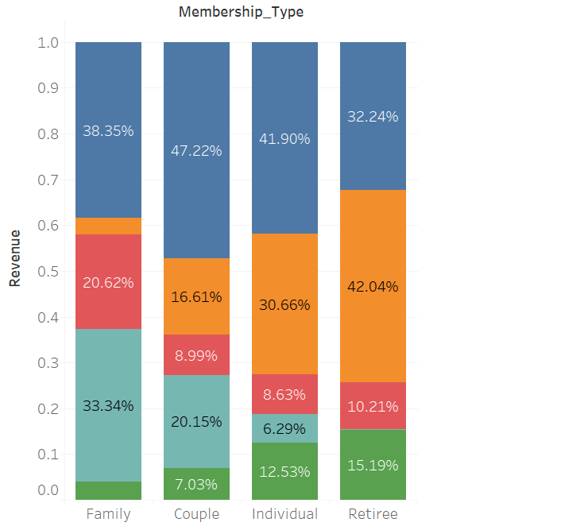
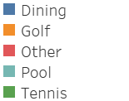
Consumption Preference of Different Types of Members
Family and couple spend most money on dining and pool.
Individual and retiree spend most money on dining and golf.
Individual and retiree are more willing to spend money on outside sports (golf and tennis) more.

Slide 7
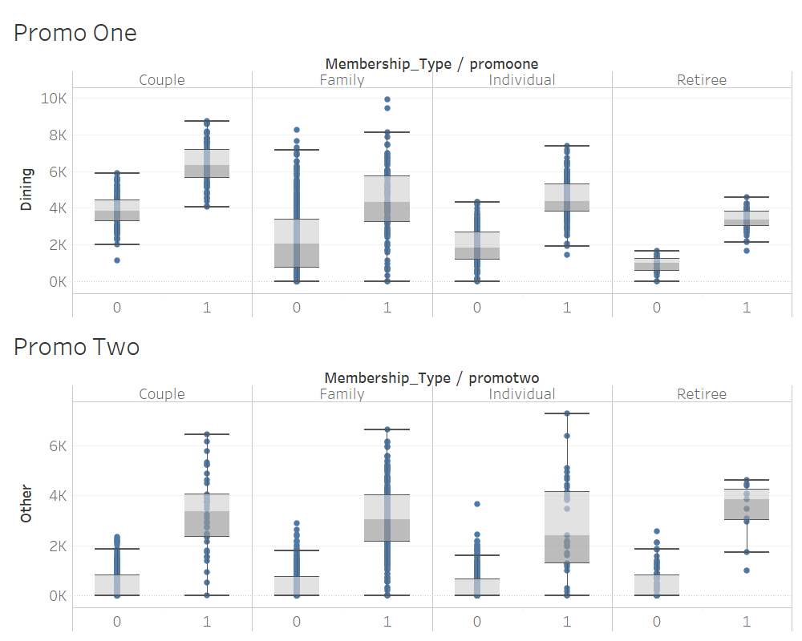
Promotion Effectiveness
Members who signed up for promo one have increased dining revenue.
Members who signed up for promo two have increased other revenue.

